Slide 1
CONTENTS
01
02
Construction of Networks
Research Background
03
04
05
Feature Learning
Machine Learning
Interpretability
Notes:
1、每节写法不统一、除了01其他节标题下都没有英文
2、文字框长度不适应下方背景框长度、章节数字与下方背景框不居中，需要一起整体修改
3、本页字体都小，留白较大，注意排版前提下尽量调大

Slide 2
PART（V） Interpretability
Diffusion Model | Biased Random Walk | Semantic Analysis Methods
Notes:
按照前几部分的意见要求修改这页

Slide 3
Why is it essential to focus on the interpretability of prediction?
Aligning with Regulatory Requirements
Enhancing Decision Reliability
Optimizing
Drug-Development Processes
Informing Subsequent Research
Z. Sun, W. Dong, J. Shi, Z. Huang. Interpretable Disease Progression Prediction Based on Reinforcement Reasoning Over a Knowlege Graph. IEEE Transactions on Systems, Man, and Cybernetics: Systems, 2024, 54(3): 1948-1959

Slide 4
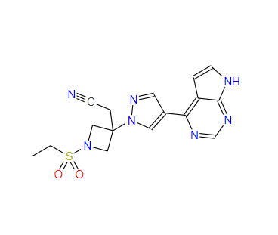

Typical Case
Baricitinib in the treatment of COVID-19
Baricitinib, initially approved for rheumatoid arthritis, has been repurposed for COVID-19 with the analysis of Multiscale Interaction Network.
Gabapentin in the treatment of AD
Gabapentin, used for epilepsy and neuropathic pain, may treat Alzheimer's disease(AD), according to the DREAMwalk model.
D. Bang, S. Lim, et al. knowledge graph learning for drug repurposing by extending guilt-by-association to multiple layers. Nature Communications, 2023, 14(1): 3570
Notes:
1、内容字体较小
2、标题字体小，不要用英文 和其他地方统一用中文

Slide 5
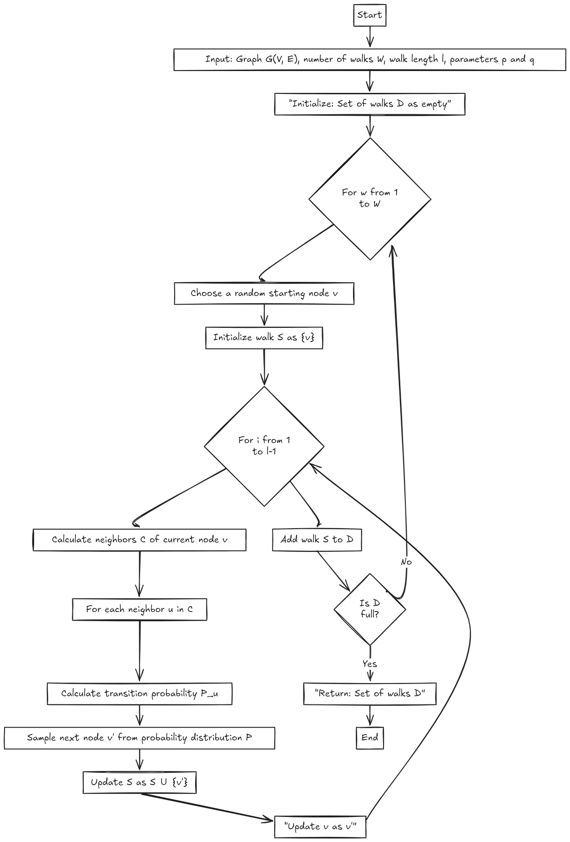

“
How to Enhance Interpretability?
Semantic Analysis
Biased random walks, by integrating information and utilizing node semantics, can be combined with diffusion models and semantic analysis, enhancing the interpretability of predictive models.
Solutions
Biased
Random-Walk(RW)
Diffusion Model
Z. Sun, W. Dong, J. Shi, Z. Huang. Interpretable Disease Progression Prediction Based on Reinforcement Reasoning Over a Knowlege Graph. IEEE Transactions on Systems, Man, and Cybernetics: Systems, 2024, 54(3): 1948-1959
Notes:
1、尽量不要用solution 用中文 放大字号
2、右侧文字描述较少，建议补充 然后重要描述加粗

Slide 6
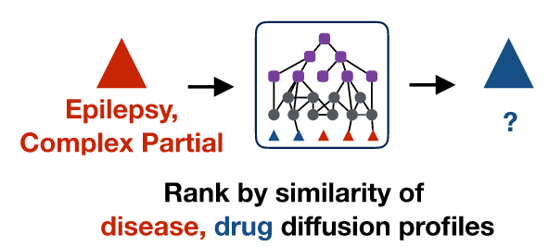
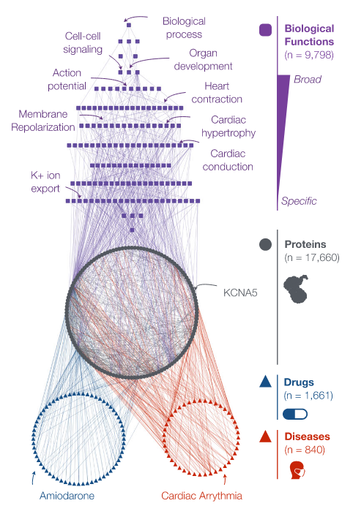
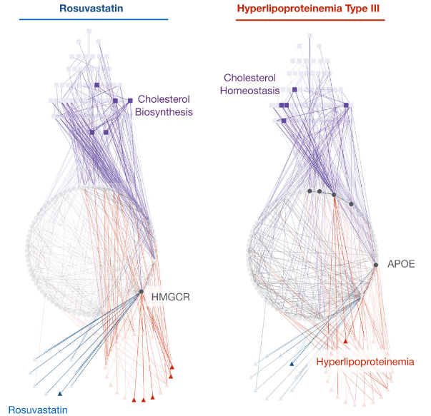
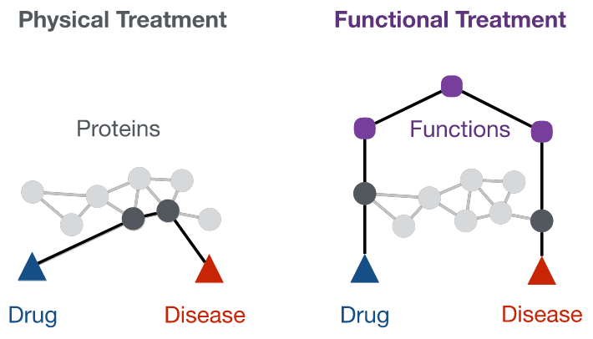

Multiscale Interaction Network: Biased RW & Diffusion Model
Network Integration
Diffusion Profile
Systematic Forecasting
Simulation of Biological Functions
C. Ruiz, M. Zitnik, J. Leskovec. Identification of disease treatment mechanisms through the multiscale interactome. Nature Communications, 2021, 12(1): 1796
Notes:
1、标题格式修改

Slide 7
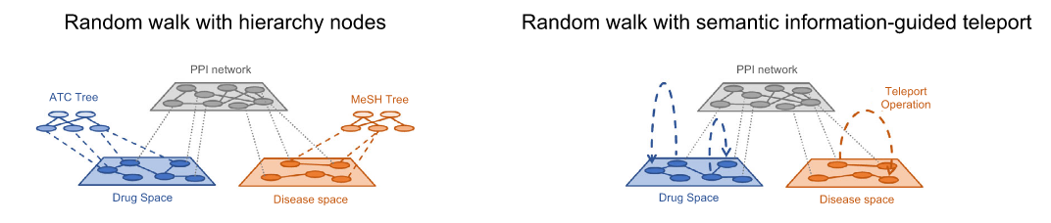
DreamWalk: Biased RW & Semantic Analysis
Multi-layer GBA
偏随机游走生成路径
语义信息引导
嵌入向量空间的探索
Multi-layer GBA
Biased RW Path Generation
Semantic Guidance
Embedding Vector Space
D. Bang, S. Lim, et al. knowledge graph learning for drug repurposing by extending guilt-by-association to multiple layers. Nature Communications, 2023, 14(1): 3570
Notes:
1、标题格式修改

